Slide 1
Practical Tools Of Value Facilitation
The World’s Leading Personalized Selling Platform
Harness AI to Accelerate
Sales And Increase revenue
Notes:
There is a lot of talk about AI today, and you should certainly think of it as available to all entrepreneurs to utilize in value creation. AI is a very open community. 85% of the AI code ever written is available today on GitHub. If you don’t have a GitHub account, you should open one. But how can AI help value creators in the way we are talking about today. By providing a resource to tap into consumer-perceived value. We’ve already mentioned personalization as a route to value creation. AI can do this.

Slide 2
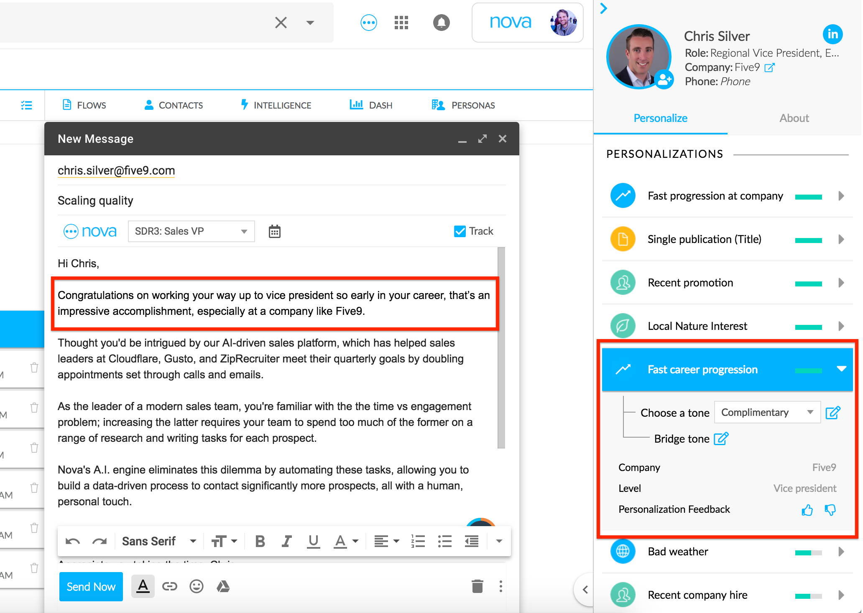
Practical Tools Of Value Creation
Personalization
Notes:
A simple task for AI is to personalize a relationship between a business and customer. Let’s take e-mail marketing as an example. AI can build a profile of a customer or a potential customer from multiple sources on the internet. Then it can auto-compose a greeting to that customer – here it is congratulating him on a promotion. The AI “knows” the customer pretty well.

Slide 3
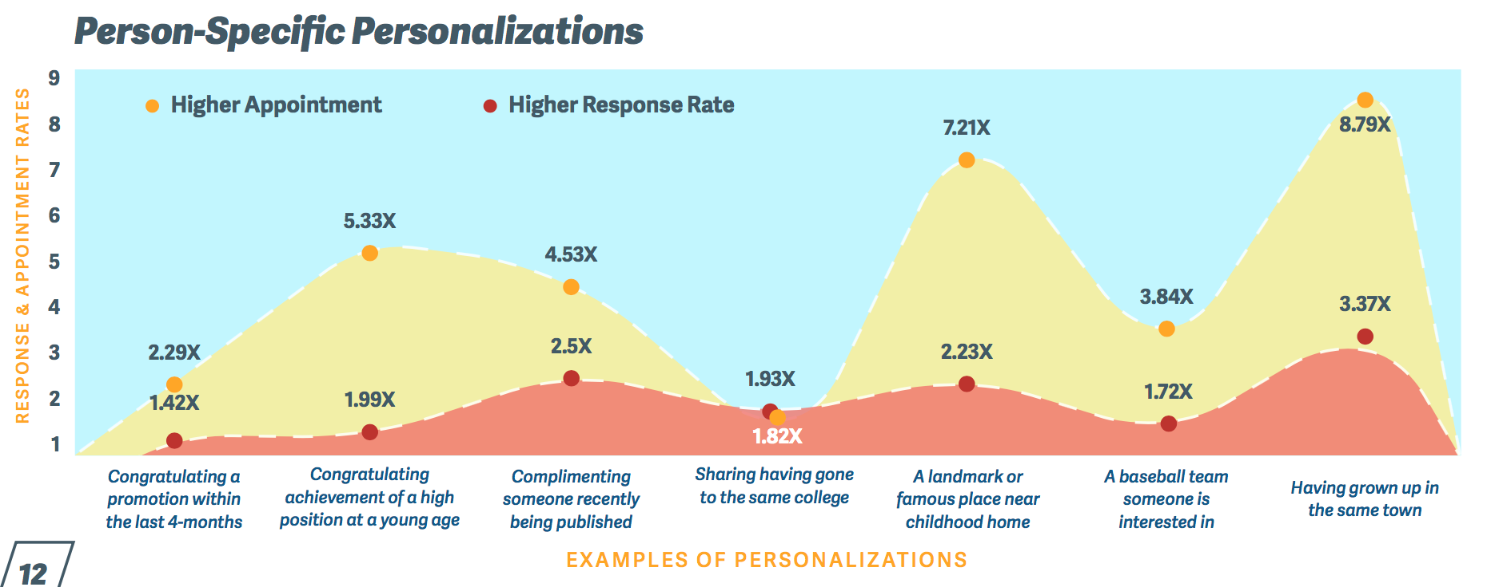
Insight
Personalization -> Warmer Feelings -> Responsiveness
Emotional Responses Can be Quantified
Notes:
But what’s the insight at work here. It is that personalized greetings stimulate a warmer feeling in the recipient. An e-mail recipient wants to feel NOT like an e-mail recipient, but like an important and well-liked person who means something to the sender. And that warmer feeling is positively correlated with behavior such as higher responsiveness, more productive meetings and a better relationship. We can even categorize the type of personalization with the quantitative analysis of results. Don’t believe that emotions can not be quantified – here is an example of quantified emotional analytics.

Slide 4
Insight
Personalization -> Warmer Feelings -> Responsiveness
Insight
Personalization > Warmer Feelings > Responsiveness
Notes:
And in this case, we exceed the 2X threshold of improvement. In some use cases, Nova helped sales teams drive 3X more revenue from targeted customers.

